Slide 1

2024 Spring SOCI2010 (Education and Society) Tutorial 1
Wanying LING
Department of Sociology
The University of Hong Kong
lingwany@connect.hku.hk
Jan 17, 2024

Slide 2
About Me
Wanying LING, PhD First-year PhD student
https://sociology.hku.hk/people/ling-wanying/
Research Interests
Health inequalities; Social Determinants of Health; Work and Health; Aging and the Life Course
Office
Room 8.25, Postgraduate Hub, The Jockey Club Tower
Email
lingwany@connect.hku.hk
Office Hours
Thursday 9:00 am – 12:00 pm or by appointment
Notes:
Hey there! I'm Wanying Ling, currently rockin' my first year as a PhD student over at HKU's Sociology Department.
Wanna check out what I'm all about? Here's the scoop 🕵️‍♀️:
Find Me Online:
Peep my profile right here 👉 Wanying LING at HKU Sociology
Stuff I'm Super Into:
Why some folks are healthier than others (Health inequalities)
How your zip code affects your health (Social Determinants of Health)
The grind of work and how it hits our health (Work and Health)
Getting older and all the life stuff that comes with it (Aging and the Life Course)
My Campus Digs:
Catch me at Room 8.25, Postgraduate Hub, The Jockey Club Tower. It's my academic lair!
Hit Me Up:
Got questions or just wanna chat? Shoot me an email at 📧 lingwany@connect.hku.hk
Office Time:
I'm around every Thursday from 9:00 am to midnight (but hey, that might be a typo, so maybe it's 12:00 pm? 🤷). Or we can set up a time that works for you—just let me know!
Let's talk life, health, and everything sociology!

Slide 3
Ground Rules about Email
Please make the course code, your FULL NAME and UID clearly in the email title.
E.g. [SOCI2010] Wanying LING – UID: 2024123456
Emails will normally be answered on Wednesdays and Thursdays
If there is something else urgent that requires a quick reply, please preface your email with [request a quick reply].
Notes:
When you're sending me an email, let's keep things neat and easy to track. Here's how we can make our email game strong:
What to Put in the Email Title:
Make sure to drop your course code, your whole name, and your UID right at the start of the email subject. It helps me help you faster!
Like this:
[SOCI2010] Wanying LING – UID: 2024123456
When to Expect a Reply:
I'll be diving into my inbox on Wednesdays and Thursdays to answer your emails, so that's when you'll hear back from me.
Need a Speedy Response?
Totally get that sometimes things can't wait. If it's super urgent, slap a [request a quick reply] at the beginning of your subject line, and I'll get back to you ASAP.
Can't wait to chat with you all via email!

Slide 4
Let's get to know each other!
Name + Year
e.g. Wanying LING, Year 1 PhD
Major/Interested Area
e.g. Sociology, focus on population health inequalities
Optional: Future Career Plan
e.g. work in Academia, or be a dog trainer…
Optional:
sociology of education studies you knew, or anything related you wish to learn?
Others
……
Notes:
Time to break the ice and spill some deets about ourselves. Here's a quick template to share who you are and what makes you tick. Just fill in the blanks or add your own twist!
👤 Who Are You? Name + What year you're in. Like: Wanying LING, Chillin' in Year 1 of my PhD journey.
📘 What's Your Jam? Your major or the cool stuff you're totally into. For example: Sociology, digging deep into why health isn't the same for everyone.
💭 Dreamin' Big? Got any grand plans for after you conquer academia? It's cool to share if you want! Maybe you're aiming to be the next big name in Sociology... or maybe you're gonna switch it up and train adorable pups.
🤔 Sociology Buff? Got any sociological theories or topics you’re already buddies with, or some you're itching to explore? Like, maybe you've got thoughts on the sociology of education or you're curious about social networks.
🌟 What Else Should We Know? Anything else you wanna toss into the mix – fun facts, your love for espresso, your TikTok handle... you do you!
Can't wait to see what everyone brings to the table! Let's make this a convo to remember. 🙌

Slide 5
Intended Learning Outcomes
Critically reflect their education experiences in connection with the basic concepts in the sociology of education.
Describe the structure, process, and function of education in modern society.
Utilise relevant theories and data to analyse educational phenomena from the sociological perspective.
Identify contemporary issues in education and discuss implications for policy and practice.
Notes:
Hey everyone! 🎓✨
Let's get our brains in gear and think back on all our school and learning adventures. We're gonna link up what we've lived through with some of the big ideas in the world of education sociology.
Here's our game plan:
Education Throwback Time: Let's chat about our own school days and see how they match up (or don't) with the fancy terms and concepts in education sociology.
School Dissected: We're gonna break down how education is built (the structure), how it works day-to-day (the process), and what it's supposed to do for us and society (the function).
Theory Meets Reality: Time to put on our detective hats and use theories and real-world data to figure out why schools work the way they do. Think like a sociologist and connect the dots.
What's the Buzz in Education Today? We'll spot the hot topics in education right now and chew over what they mean for the people making the rules and for all of us living by them.
So, grab your thinking caps and let's get sociological about school! 🧠📚
Remember, it's all about spotting patterns, asking "why," and making sense of the education world around us. Let's get to it! 🚀

Slide 6
Tutorial Plan
Week | What We're Doing (Wednesdays are our days!) | What You Need to Do
T1 (Jan 24) | - Get into teams. - Start our awesome group project. | Just show up and be ready to team up!
T2 (Jan 31) | - Pick an article and dive into it.
T3 (Feb 7) | - Break down the article. - Brainstorm your own research question and some smart guesses (hypotheses). | Shoot over your article choice and a snappy summary to your tutor (ME!) by Feb 19. Don't miss it!
👀 No tutorial this week!
T4 (Feb 21) | - Lock down your research question. - Chat about how we're gonna gather and crunch numbers (data stuff). | If you're gathering your own data, bring your ethics forms today, alright?
T5 (Feb 28) | - Make sure our data game plan is solid.
T6 (Mar 13) | - Wrap up data collection (grab more if you need to).
T7 (Mar 20) | - It's data analysis time. Let's make sense of those numbers.

Slide 7
Tutorial Plan
Week | What We're Doing (Wednesdays are our days!) | What You Need to Do
T8 (Mar 27) | - More data analysis
T9 (Apr 3) | - Talk about what it all means (implications).
T10 (Apr 10) | - Keep the discussion going on implications.
T11 (Apr 17) | - Showtime! Present your findings. | Slide your presentation to your tutor (ME!) within 24 hours after you present. Stay on the ball!
T12 (Apr 24) | - Showtime! Present your findings. | A project summary need to land in your tutor's inbox (ME!) by Apr 30.
🚀 Remember: Keep these dates in mind, and let's nail this project together! 🎉

Slide 8
Grading
Showing Up & Joining In (20%)
Ask for leave in advance if you need to (valid proof/醫生紙 is required)
The Big Project (40%)
The Final Boss: Examination (40%)
I will send out questionnaires after presentation, and each group member will evaluate the scores of the other members of their group.
Notes:
Alright class, let's break down how we're gonna score this semester:
📝 Your Grade Recipe:
Showing Up & Joining In (20%)
Make some noise in lectures and tutorials because participation is key! It's a chunky 20% of your grade.
👉 Need to miss a day? No stress, just let me know ahead of time. Don't forget to bring a note from the doc (yup, that means a valid proof or 醫生紙) if you're under the weather.
The Big Project (40%)
Roll up your sleeves, because this project is a biggie! It's 40% of your total grade, so let your brilliance shine!
The Final Boss: Examination (30%)
Show off what you've learned! The exam is the final hurdle and another 30% of your grade.
Just a heads up, the total adds up to 100%, so looks like there's a typo in the original breakdown. Double-check with your instructor to see if it's 30% for participation and 30% for the exam, or some other combo.
Now that you know how the grading work

Slide 9
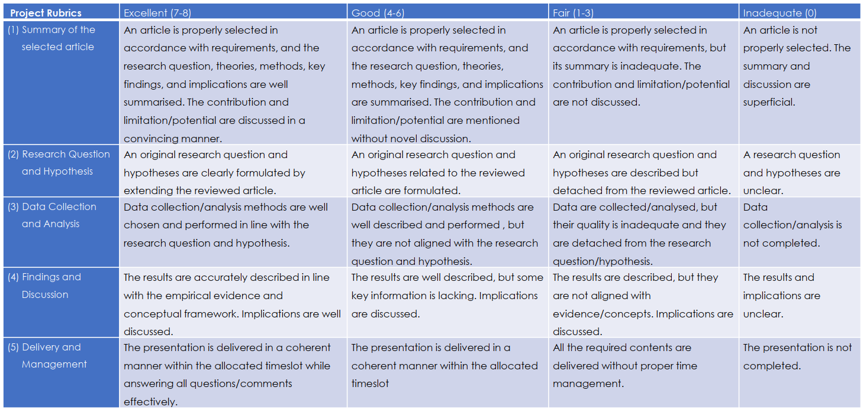
Grading - Project

Slide 10
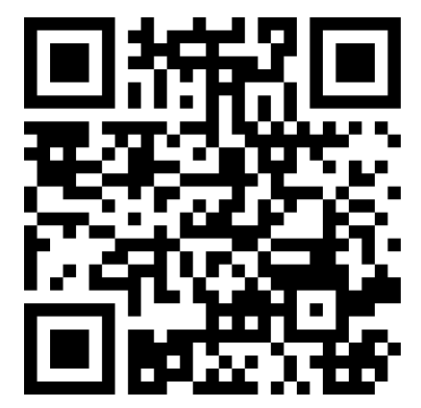
Scan to vote: (make sure to enter your full name)
You will be divided into small groups based on…..?
(c. 6-7 ppl for each group, subject to change depending on # of enrolled students)
Notes:
📊 Time to Make Your Voice Heard: Scan to Vote!
Before you vote, remember: 📝 Enter Your Full Name - Yep, we gotta know who's casting the vote.
👥 Grouping Up! You'll be sorted into cozy little crews for this adventure:
Around 6-7 peeps per squad, give or take.
The final group size might shuffle a bit depending on how many of us are joining the party (aka enrolled students).
So, ready to team up and make some decisions? Let's do this!

Slide 11
Hi!
Say Hi to your group mates, exchange your contacts
Each group will conduct a research project about the sociology of education
* Assess the contribution of yourself and your teammates (i.e., self-peer assessment)!
Notes:
It's time to get our social gears turning and kick off an awesome research project on the sociology of education. But first, let's get to know each other a bit!
📲 Swap Those Digits & Socials: Drop your contact info so we can stay in the loop with each other. Phone numbers, email, WhatsApp, Discord, carrier pigeon—whatever works best!
📚 Our Mission: Sociology of Education Research Project We're gonna dive deep into how society shapes education and vice versa. It's gonna be epic!
📈 Teamwork Makes the Dream Work: Remember, we're in this together. When we wrap up, we'll all have a chance to reflect on how we did with a self-peer assessment. It's like a group selfie but for our contributions to the project!
Let's bring our A-game and make this research project one for the books! 🌟

Slide 12
Presentation
As a deliverable of the project, each group will make a presentation. (c. 20mins, subject to change depending on # of enrolled students)
Introduction
Literature Review
Research Questions, Hypotheses
Methods and data
Analysis results
Discussion and Conclusion
Balanced Division of Labour
Notes:
🎤 Presentation Time, Team!
Get ready to shine because we're gonna wrap up our project with a presentation that'll knock everyone's socks off. Here's what we're aiming for:
⏱ Presentation Duration:
We've got around 20 minutes to showcase our hard work.
Heads up: This might be adjusted based on the number of teams presenting, so let's stay flexible!
📝 Our Presentation Breakdown:
Introduction
Set the stage: What's our project about, and why should the audience care?
Literature Review
Show off our homework: What have other smarty-pants said about the sociology of education?
Research Questions & Hypotheses
The big "whys" and "what ifs" we're tackling.
Methods and Data
Nerd out: How did we dig up our info and what tools did we use?
Analysis Results
Drop the knowledge: What did we find out?
Discussion and Conclusion
The grand finale: What do our results mean, and why do they matter?
Balanced Division of Labour
Every voice matters: We'll make sure everyone's work shines.
🎩 Tips for a Smooth Presentation:
Rehearse: Let's practice to keep within our time limit and smooth out any kinks.
Visual Aids: Slide decks, charts, and graphics will be our best friends.
Engage the Audience: We're not just talking at them; we're sharing a story.
Backup Plan: Tech fails happen. Let's have a Plan B for our presentation.
Let's rock this presentation and end with a bang! 🌟

Slide 13
Next week
Choose a journal article on sociology of education
Bring in next week to share and discuss

Slide 14
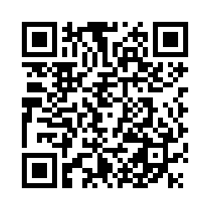
Tell me!
https://hku.au1.qualtrics.com/jfe/form/SV_0CAc6wAIyoTfH4W

Slide 15

Thank you!
Wanying Ling
lingwany@connect.hku.hk

